Slide 1
Polynomial Regression
by Bernie Tao

Slide 2
Concept
Engineers and scientists are constantly searching for models to explain and predict behavior of systems. These models are usually developed from sets of data points, e.g. x_{i}, y_{i}, i = 1, 2, ... m. The concept of regression is to quantitatively fit a model to a set of data using objective criteria. Polynomial functions are used most often due to the ease of computation and readily obtained derivatives and integrals.

Slide 3
Least Squares Criterion
The fitting criterion used is the least squares criterion (LSC). LSC states that the “best” fit is obtained when the sum of the squares (S) of the deviations (d_{i}) between the data and the model is minimized. In other words, the model function fits the data points in such a way that the sum of the distances between the data and the model are minimized.

Slide 4
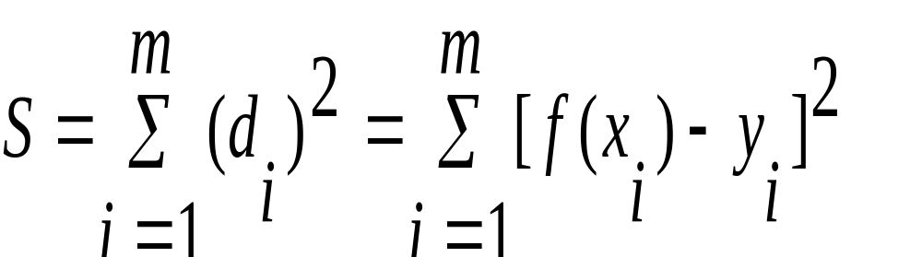
Mathematical Definition
where f(x) = a₀ + a₁x + a₂x² + a₃x³ + ... a_{n}x^{n}.
To minimize S, set the partial derivatives with respect to each coefficient to zero.

Slide 5
Mathematical Definition
(cont’d)
The set of partial derivatives is called the characteristic equations for the model. The solution of the characteristic equations provides values for the polynomial coefficients.
NOTE: There are n+1 equations for an nth order polynomial.

Slide 6
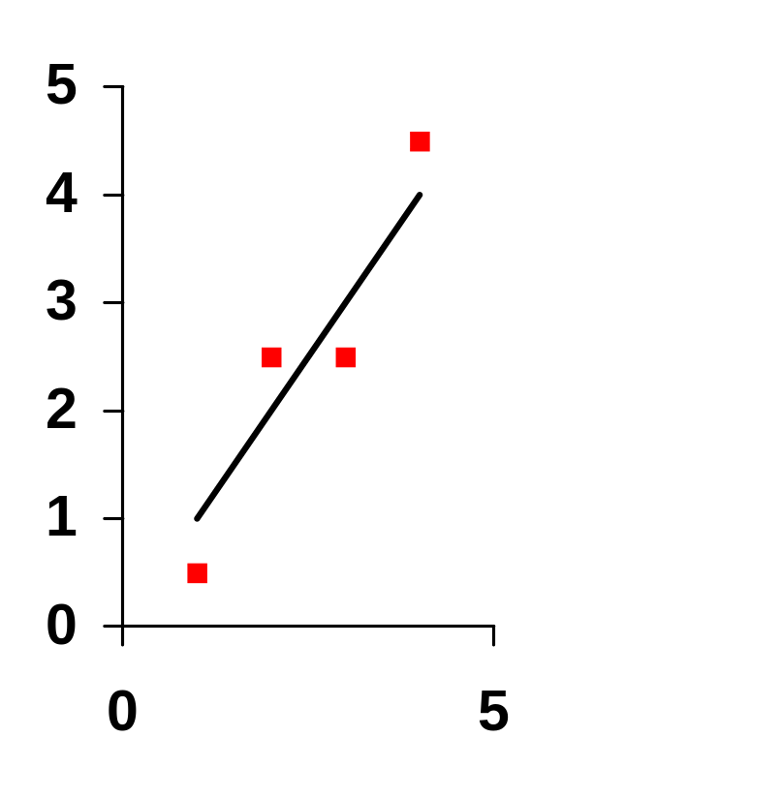
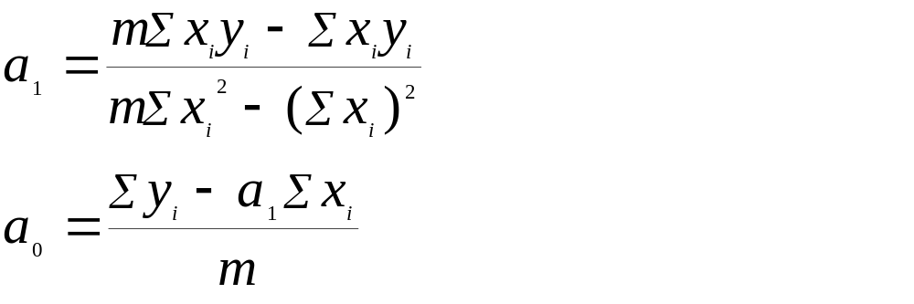
Linear Regression
The simplest polynomial is a linear model, f(x) = a₀ + a₁x
This model has two parameters, a₀ and a₁.

Slide 7
Measuring Fit
There are two measures for assessing how well a regressed curve fits data values
Correlation Coefficient, r
Standard Error, SE

Slide 8
Correlation Coefficient
The correlation coefficient provides a statistical measure of how well the model fits the data.
The value of correlation coefficient is the ratio of the sum of the squares of the deviations of the model values (from the average, Y), to the sum of the squares of the deviation of the actual y values (from Y).

Slide 9
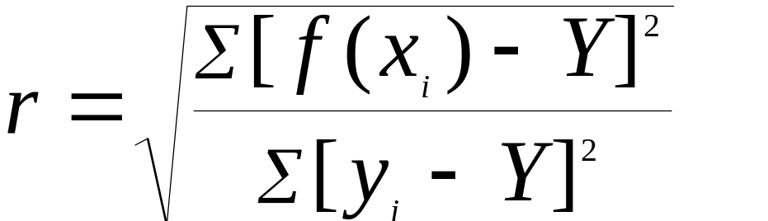
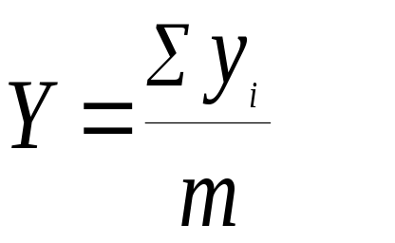
Correlation Coefficient
(cont’d)
Numerical values of r range from -1 < r < +1. Values of +/- 1 indicate a perfect positive/negative correlation. A value of r = 0 indicates no correlation.
Rule of Thumb - correlation coefficients > 0.9 indicate a reliable model fit to the data.

Slide 10
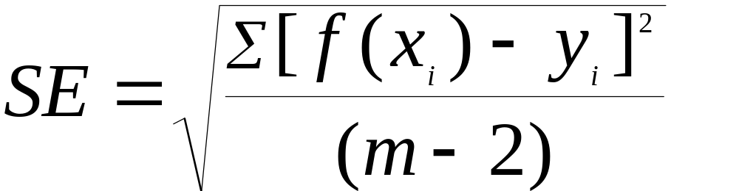
Standard Error
The standard error is a statistical measurement of how widely dispersed the data values are around the model.
The smaller the SE the tighter the fit of the model to the data.
An SE = 0 means that the model exactly fits the data.

Slide 11
Standard Error
(cont’d)
NOTE: The denominator in the SE equation is (m-2). This accounts for the loss of an additional degree of freedom due to the constraints of the average and of the polynomial regression equation model.

Slide 12
Polynomial Regression
The general form of a polynomial is
f(x) = a₀ + a₁x + a₂x² + a₃x³ + ... + a_{n}x^{n}
Using the LSC, expanding the polynomial function in the square of the deviations, and setting the partial derivatives of S with respect to each coefficient to zero, yields the set of characteristic equations.

Slide 13
Polynomial Regression
(cont’d)
Solving the set of characteristic equations can be accomplished by using linear algebra matrix methods.
Σm
Σx
Σx²
.
.
.
Σx^{n}
Σx
Σx²
Σx³
.
.
.
Σx^{n+1}
Σx²
Σx³
Σx⁴
.
.
.
Σx^{n+2}
Σx^{n}
Σx^{n+1}
Σx^{n+2}
.
.
.
Σx^{2n}
a₀
a₁
a₂
.
.
.
a_{n}
Σy_{i}
Σx_{i}y_{i}
Σx_{i}²y_{i}
.
.
.
Σx_{i}^{n}y_{i}
=

Slide 14
Polynomial Regression
(cont’d)
In matrix shorthand from, X * A = Y.
To solve for A, the inverse of the X matrix is taken and multiplied by the Y vector, A = X⁻¹ * Y
Matrix inversion and multiplication are very tedious by hand, but modern computers simplify these operations.

Slide 15

How to do Calculations
Polynomial Regression
Make a list of all your data values
Determine the order (n) of the polynomial model you wish to use. Make a table of powers of x, x², ... x^{2n}, and yx, yx², ... yx^{n}
For linear regression, plug the summation values into the equation and solve for a₀ and a₁. Also, calculate r and SE.

Slide 16
How to do Calculations
Polynomial Regression
(cont’d)
For polynomial regression, set up characteristic equation matrix X and vector Y.
Invert characteristic equation matrix
Multiply inverted characteristic equation matrix X⁻¹ by Y vector to obtain the coefficient matrix A
Calculate values for r and SE

Slide 17
Example #1
Calculate the best fit line through the following data.
x
0
1
2
3
4
y
2
4
7
9
12

Slide 18
Example #1
(cont’d)
5 Σ x_{i}y_{i} - Σ x_{i} Σ y_{i}
Σ y_{i} - a₁ Σ x_{i}
a₁ =
a₀ =
5 Σ x_{i}² - (Σ x_{i})²
5
a₁ = 2.5
a₀ = 1.8
f(x) = 2.5 x + 1.8

Slide 19
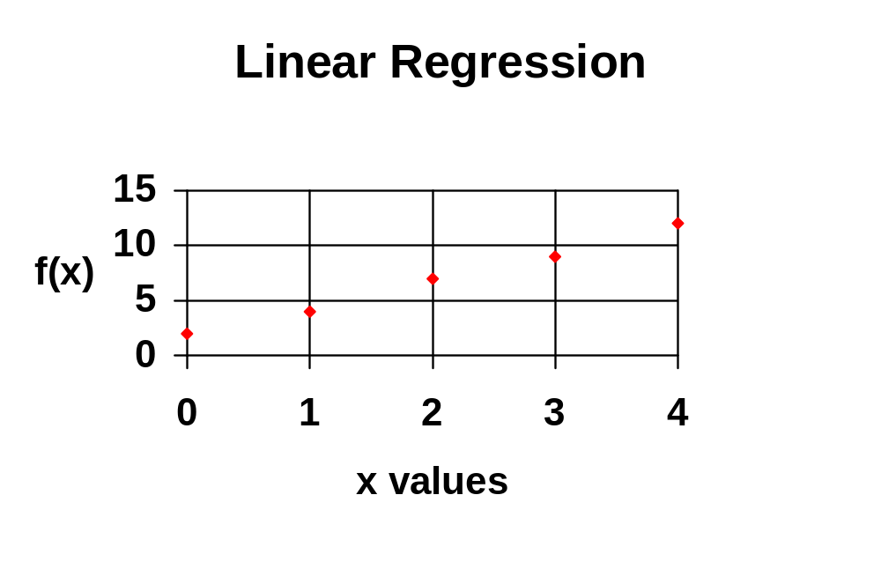
Example #1
(cont’d)

Slide 20
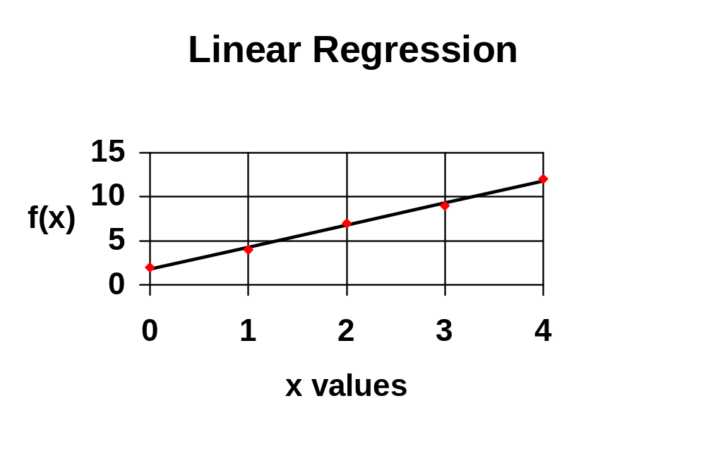
Example #1
(cont’d)
r = 0.929523
SE = 0.316228

Slide 21
Example #2
Fit the following data with a 4th order polynomial.
x
1
4
10
17
25
33
y
5
15
27
12
9
7

Slide 22
Example #2
(cont’d)
Create a summation table for the powers of x an xy. The x sums go up to the power of x^{2n} and the xy sums go to yx^{n}.
Invert the characteristic equation matrix and multiply times the Y vector to get the coefficient vector.
f(x) = -3.8945 + 8.2894x - 0.79528x² + 0.02718x³ - 0.00031x⁴

Slide 23
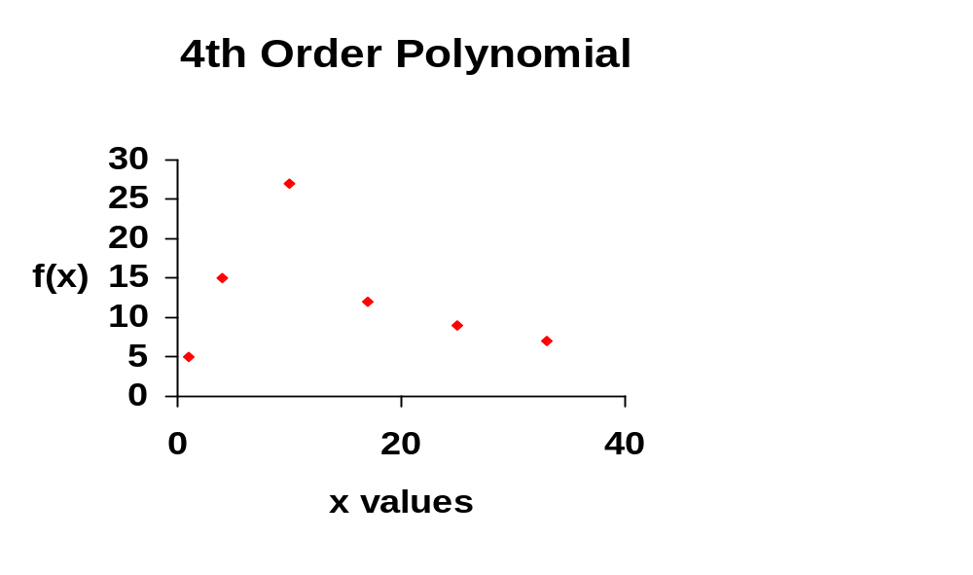
Example #2
(cont’d)

Slide 24
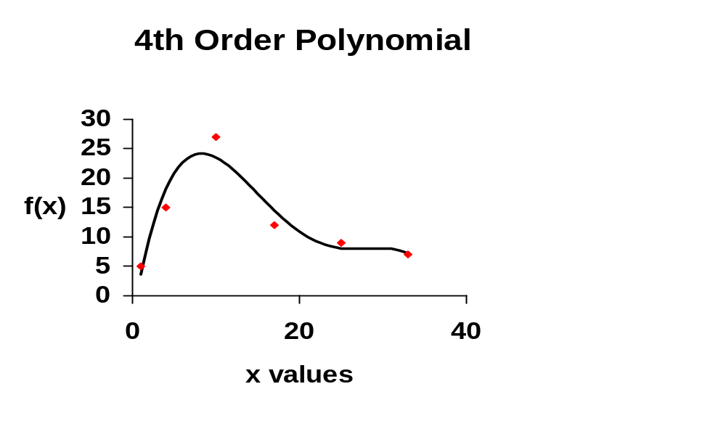
Example #2
(cont’d)
r = 0.949242
SE = 2.793545

Slide 25
Limitations of Polynomial Regression
The main limitation of polynomial regression is that it becomes oscillatory as the order of the polynomial increases
Another limitation of regression is the computational requirement as the polynomial order and the number of data points becomes large. Computational error may limit the utility of this method.

Slide 26
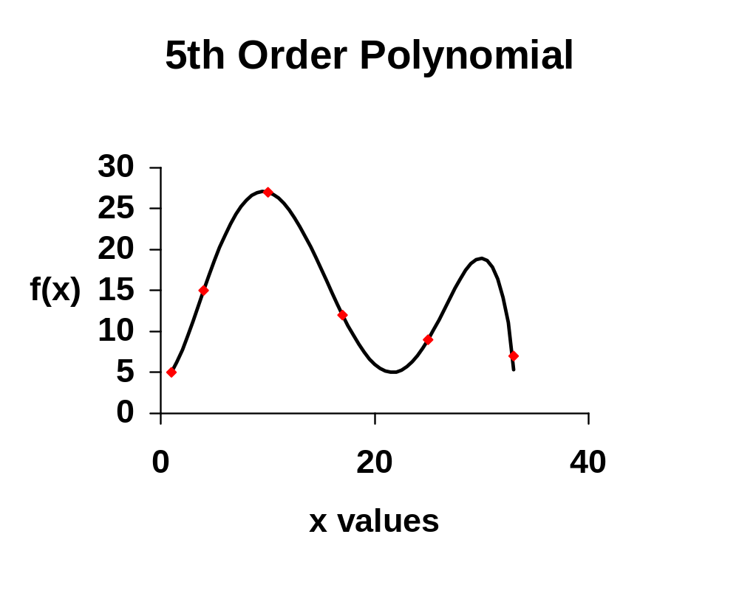
Limitations of Polynomial Regression (cont’d)
This example illustrates the oscillatory nature of polynomials. This is a 5th order polynomial of the data in Example #2. The statistical fit of this model is perfect. At first the behavior is consistent with our expectations, but unlike the expected behavior, the model oscillates extensively over the last 3 data values.

Slide 27
Concepts and Skills to Know
Explain the linear least squares criterion (LSC).
Explain the method of regression.
Explain the correlation coefficient and standard error.
Explain the advantages and disadvantages of polynomial regression.
Calculate a regression polynomial model from data.

